Slide 1
Component Selection and Controller
Controller
Discrete Component Selection
Discussion of Changed Parts

Slide 2
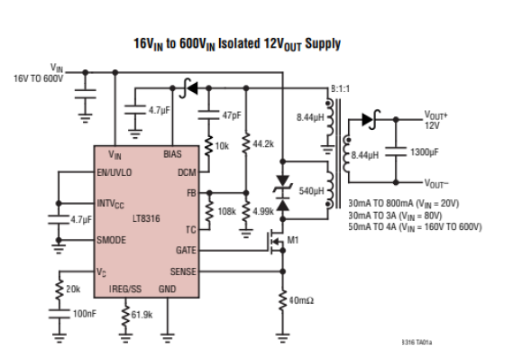
Component Selection and Controller
A. Controller
Requirements: 220V-400V input, 100W
LT8316: 16V-600V input/External MOSFET → We can select MOSFET for 100W operation
Figure-7:
Typical Application of LT8316

Slide 3
Component Selection and Controller
Feedback is taken from tertiary winding → No galvanic isolation is needed!
Reduces cost and complexity!
No need for extra logic power supplies, digital isolators and signal conditioning!

Slide 4
Component Selection and Controller
Idea of operation:
Feedback is taken from tertiary winding and sampled by FB pin.
DCM pin senses dV/dt and adjusts boundary operation.
With boundary operation output diode voltage drops to zero in every cycle, stress on diode is reduced.
With boundary mode, we are able to use a smaller transformer compared with CCM.
By adjusting sense resistor, output current is limited.
By adjusting UVLO resistors, protection is handled for low voltage

Slide 5

Component Selection and Controller
B. Discrete Component Selection
Feedback Resistors:
→48.1k / 5k resistors are calculated!
→Simulation gives better solution with 47k / 5k resistors!
Nts=1
Vf=0.95V
Vout=12V

Slide 6

Component Selection and Controller
Sense Resistor:
→ Calculation gives us 17.5mohm sense resistor!
Nps=26/6
D=0.2 max
Iout=8.33A
→ We have selected 10mohm sense resistor in order to supply higher currents!

Slide 7

Component Selection and Controller
UVLO Resistors:
→ This calculation gives us 1.5Megaohm / 9.2kohm resistors for voltage division!
We will take the circuit protection under 200V input!
UVLO pin compares the input voltage with 1.22V
Protection Circuit Bonus!

Slide 8
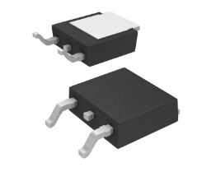
Component Selection and Controller
MOSFET Selection:
In detailed simulation, we have seen that MOSFET sees maximum 450V and 6A
We have selected Infıneon Technologies IPD50R500CEAUMA1 with 550V, 7.6A ratings! (DPAK)

Slide 9
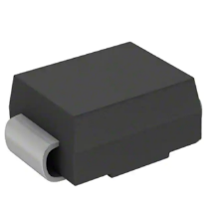
Component Selection and Controller
Output Diode Selection: (Changed Part)
In detailed simulation, we have seen that output diode sees maximum 110V and 22A peak, 8.33A rms current.
In simulation report 170V, 30A diode was selected.
We have selected Comchip 150V, 3A CDBB3150-HF, and paralleled 5 of them, to not to use heatsink.

Slide 10
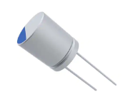
Component Selection and Controller
Tertiary Diode Selection:
In detailed simulation, we have seen that tertiary diode sees maximum 110V and 100mA
We have selected STMicroelectronics STPS1150A with 150V, 1A ratings
Output Capacitor Selection:
In detailed simulation, output capacitor has 20A ripple, and ESR must not exceed 24mohm to stay %4 ripple!
We have selected KEMET A750KK337M1CAAE014, 330uF, Aluminum-Polymer, 5A ripple, 14mOhm ESR, and we will parallel four of them, by this way, we will decrease ESR, too.

Slide 11
Component Selection and Controller
RCD Snubber Selection (Changed Part)
Datasheet recommends a D-Z snubber for safe switching,in simulation report, we have used a D-Z snubber, however it could not handle leakage flux overshoot on MOSFET.
We have used an RCD snubber to handle overshoot.
Diode: Vishay S1J-E3/61T, 600V, 1A
Capacitor: 0.1uF
Resistor: 5.6kOhm, 4W

Slide 12
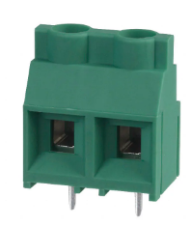
Component Selection and Controller
Connector (Changed Part)
Two input screw terminal for both input and output.
Input is capable up to 600V, 24A
Output is changed to 125V, 12A screw terminal to decrease cost and space

Slide 13
Component Selection and Controller
TVS Diode (New Part)
To prevent circuit from overvoltage situation, we have added a TVS diode to the input
The voltage will be clamped after 400V
Eaton Electronics SMBJE400CA 400V TVS diode
Protection Circuit Bonus!

